Slide 1
Legend

Slide 2




Bar Plot in
https://www.kharwal.com

Slide 3
Bar plots are used to display values associated with categorical data.
The bar plots can be plotted horizontally or vertically.
A bar plot describes the comparisons between the discrete categories.

Slide 4
Syntax

Slide 5
plt.bar(x, height, width, bottom, align)

Slide 6
The parameters to the function are:
x: sequence of scalars representing the x coordinates of the bars.
Height: scalar or sequence of scalars representing the height(s) of the bars.
Width: The width can scalar or array. It is optional. By default width of the bar is 0.8

Slide 7
Bottom: The bottom can be scalar or array, it is also optional. The default value is None.
Align: The align value can be centre or edge. It is optional. The default value is centre.

Slide 8
Horizontal Bar Plot

Slide 9
We can show the exact same chart horizontally using plt.barh()

Slide 12

Thank you!
Please like & subscribe our channel.

Slide 13
Types of Plot

Slide 14
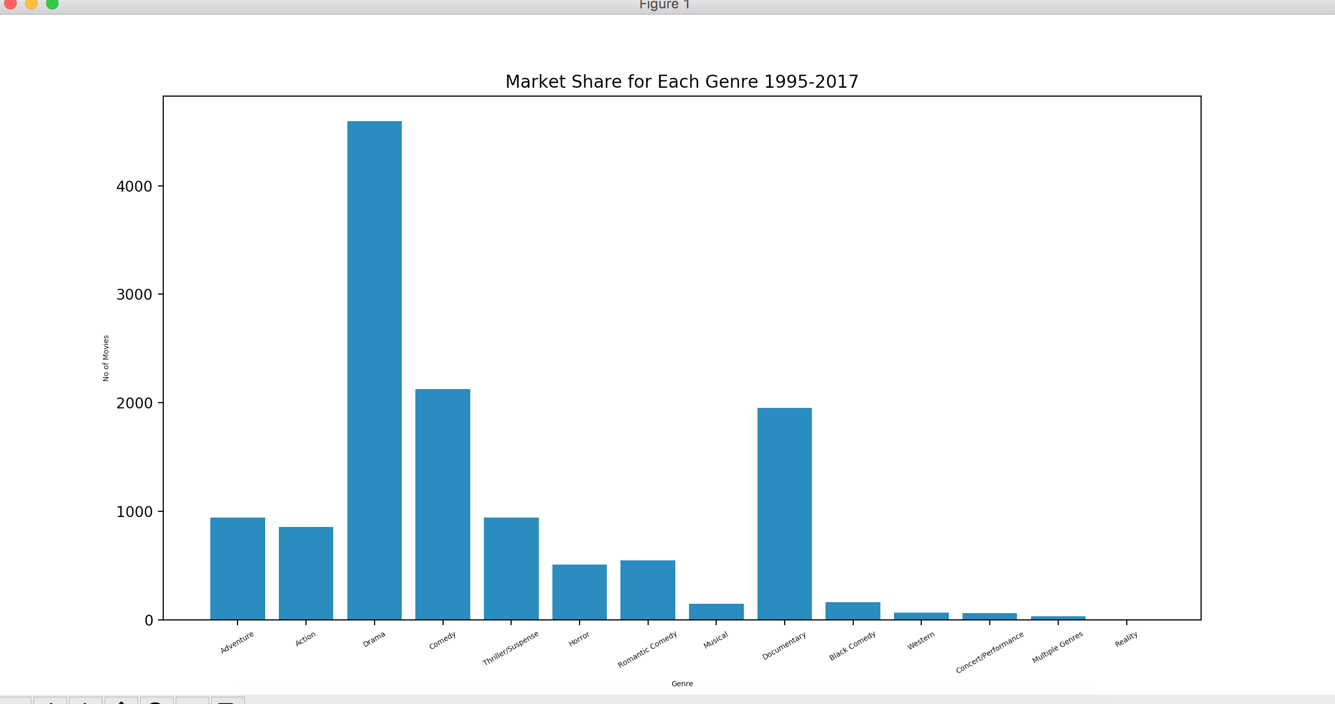
Bar Graph

Slide 15
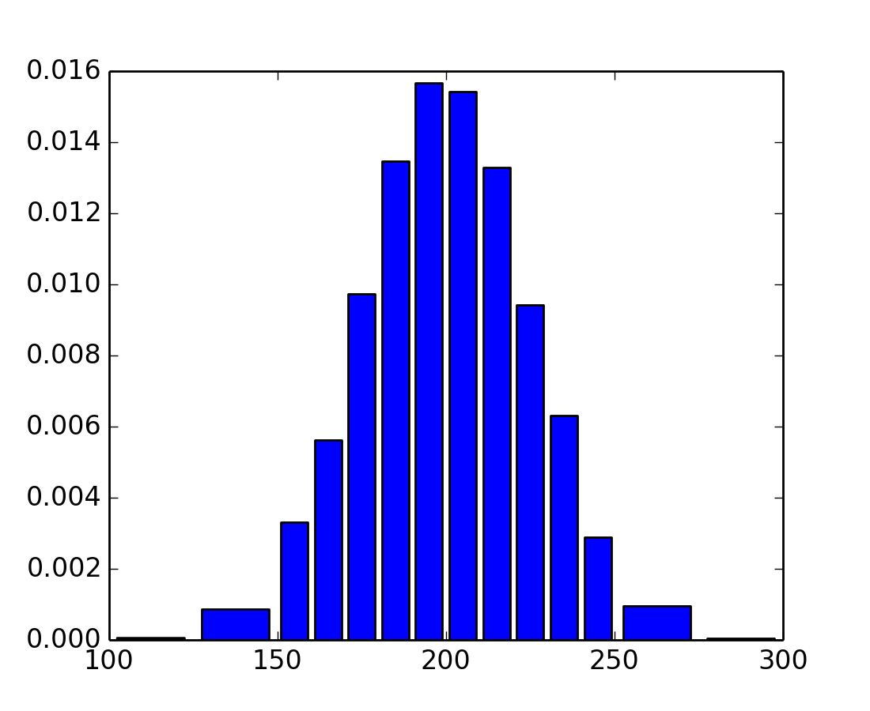
Histogram Graph

Slide 16
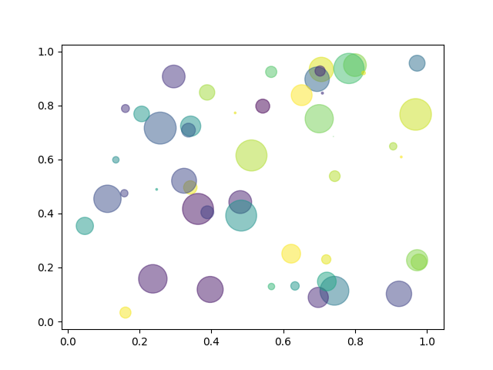
Scatter Plot

Slide 17
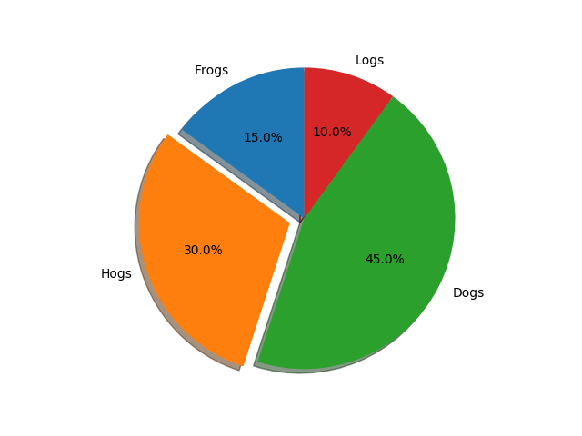
Pie Plot

Slide 18
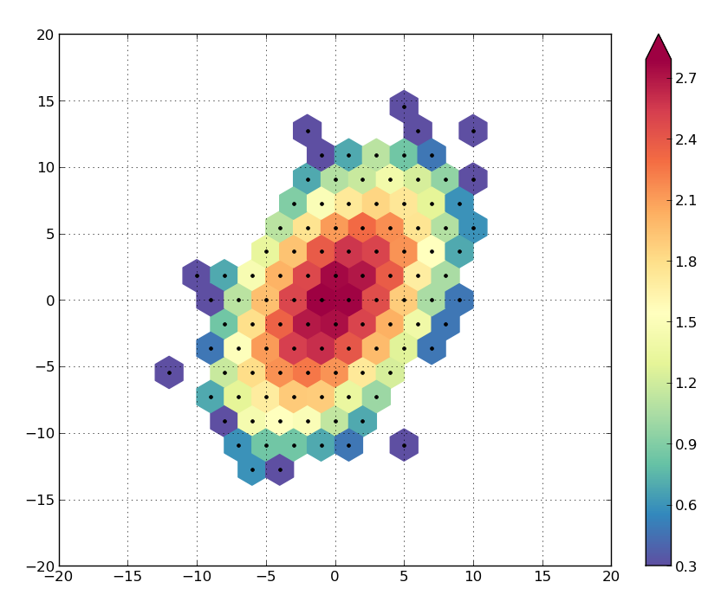
Hexbin Plot

Slide 19
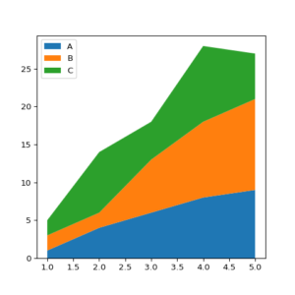
Area Plot

Slide 20
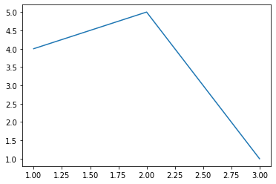
Create First Plot:
from matplotlib import pyplot as plt
plt.plot([1,2,3],[4,5,1])
plt.show

Slide 21
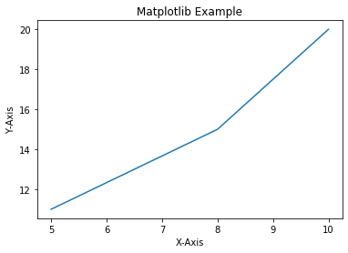
Add Labels and Title to Plot:
from matplotlib import pyplot as plt
x=[5,8,10]
y=[11,15,20]
plt.plot(x,y)
plt.title('Matplotlib Example')
plt.xlabel('X-Axis')
plt.ylabel('Y-Axis')
plt.show()

Slide 22
Add Styles to Plot:
from matplotlib import style
style.use('ggplot')
x1=[5,8,10]
y1=[12,16,23]
x2=[17,13,45]
y2=[15,20,30]
plt.plot(x1,y1,'g',label='Line One',linewidth=5)
plt.plot(x2,y2,'c',label='Line Two',linewidth=5)

Slide 23
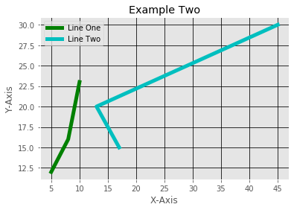
plt.title('Example Two')
plt.xlabel('X-Axis')
plt.ylabel('Y-Axis')
plt.legend()
plt.grid(True,color='k')
plt.show()

Slide 24
Bar Plot:
x1=[5,8,10]
y1=[12,16,23]
x2=[17,13,45]
y2=[15,20,30]
plt.bar(x1,y1,label='Example One')
plt.bar(x2,y2,label='Example Two')
plt.legend()
plt.xlabel('X-axis')
plt.ylabel('Y-axis')

Slide 25
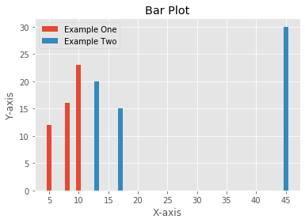
plt.title('Bar Plot')
plt.show()

Slide 26
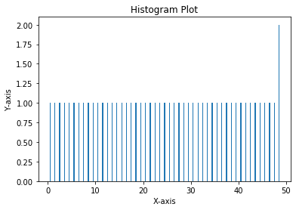
Histogram:
pa=range(50)
bins=range(50)
plt.hist(pa,bins,histtype='bar',rwidth=0.2)
plt.xlabel('X-axis')
plt.ylabel('Y-axis')
plt.title('Histogram Plot')
plt.show()

Slide 27
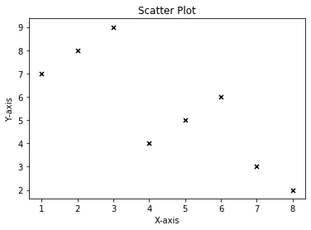
Scatter Plot:
x3=[1,2,3,4,5,6,7,8]
y3=[7,8,9,4,5,6,3,2]
plt.scatter(x3,y3,label='Arvind',color='k',s=25,marker='x')
plt.xlabel('X-axis')
plt.ylabel('Y-axis')
plt.title('Scatter Plot')
plt.show()

Slide 28
Stack Plot:
D=[1,2,3,4,5]
S=[7,8,6,11,7]
E=[2,3,4,3,2]
W=[7,8,7,2,2]
P=[8,5,7,8,13]
plt.plot([],[],color='m',label='D',linewidth=5)
plt.plot([],[],color='c',label='S',linewidth=5)
plt.plot([],[],color='r',label='E',linewidth=5)
plt.plot([],[],color='k',label='W',linewidth=5)
plt.plot([],[],color='g',label='P',linewidth=5)

Slide 29
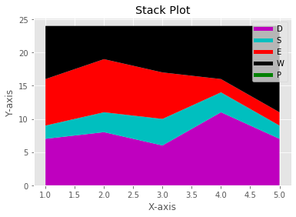
plt.stackplot(D,S,E,W,P,colors=['m','c','r','k','y'])
plt.legend()
plt.xlabel('X-axis')
plt.ylabel('Y-axis')
plt.title('Stack Plot')
plt.show()

Slide 30
Pie Plot:
slices=[7,2,4,3]
Name=['A','B','C','D']
clrs=['c','m','r','b']
plt.pie(slices,
labels=Name,
colors=clrs,
startangle=90,
shadow=True,
explode=(0,0.1,0,0),
autopct='%.2f%%'
)

Slide 31
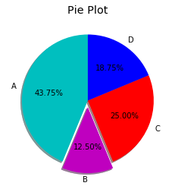
plt.title('Pie Plot')
plt.show()

Slide 32
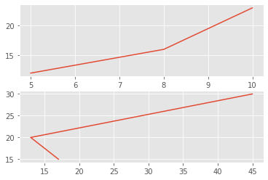
Working With Multiple Plots:
x1=[5,8,10]
y1=[12,16,23]
x2=[17,13,45]
y2=[15,20,30]
plt.subplot(211)
plt.plot(x1,y1)
plt.subplot(212)
plt.plot(x2,y2)
plt.show()

Slide 33
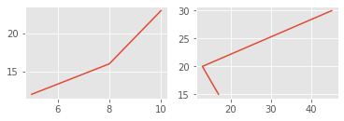
x1=[5,8,10]
y1=[12,16,23]
x2=[17,13,45]
y2=[15,20,30]
plt.subplot(221)
plt.plot(x1,y1)
plt.subplot(222)
plt.plot(x2,y2)
plt.show()

Slide 34
Plt.subplot(211)
2 means we have 2 plots in this plot.
1 means Horizontally we have only one plot
1 means this is plot number 1

